Slide 1
CSSE 332 Advanced Page Tables
Tuesday, February 5, 2019

Slide 2
Questions
What Is the problem with page table?
Solutions:
Multi-index Page Table
Inverted Page Table

Slide 3
Virtual Memory Space
Physical Memory Space
0000
0001
0010
0011
0100
0101
0110
0111
1000
1001
1010
1011
1100
1101
1110
1111

Slide 4
Virtual Memory Space
0000
0001
0010
0011
0100
0101
0110
0111
1000
1001
1010
1011
1100
1101
1110
1111
Virtual Memory Address
01 01
Page
Number
Offset
Page Table Address
Valid,Frame#
1 | 10
1 | 00
1 | 11
0 | 01
00 01
Physical Memory Address
Frame
Number
Offset

Slide 5
Divide virtual address space into fixed sized pages
Each page maps to a physical page frame or PFN
PFN 00
PFN 01
PFN 02
PFN 03
PFN 04
PFN 05
PFN 06
PFN 07
PFN 08
PFN 09
PFN 0A
PFN 0B
PFN 0C
PFN 0D
PFN OE
PFN 0F
...
PFN FE
PFN FF
Stack | Page 0
Stack | Page 1
Free | Page 2
 | Page 3
 | Page 4
 | Page 5
 | Page 6
 | Page 7
 | Page 8
 | Page 9
 | Page A
 | Page B
 | Page C
Heap | Page D
Data | Page E
Code | Page F

Slide 6
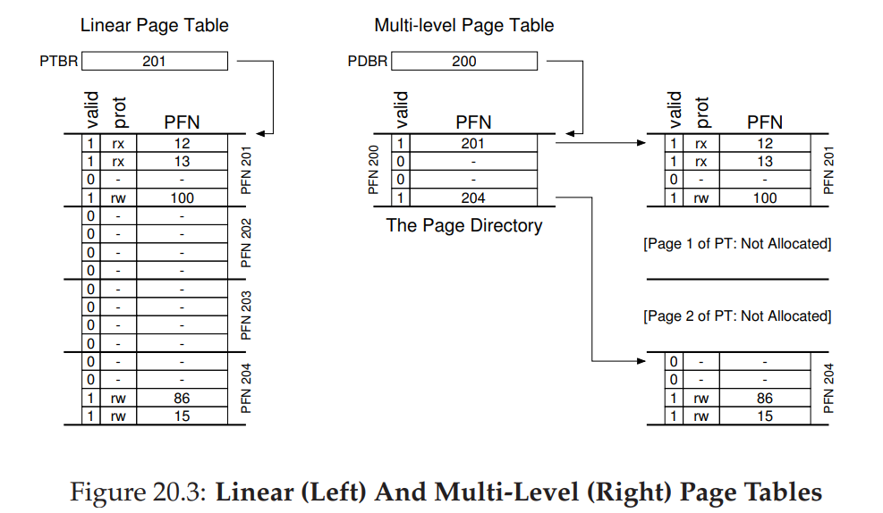
?

Slide 7
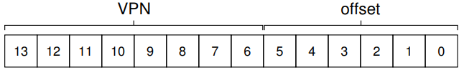
Design 2-Level Page Table
Imagine a small address space of size 16KB, with 64-byte pages. Thus, we have a 14-bit virtual address space, with 8 bits for the VPN and 6 bits for the offset.
Full regular page table (in this example) has 256 entries; assume each PTE is 4 bytes in size. Thus, our page table is 1KB (256 × 4 bytes) in size. Given that we have 64-byte pages, the 1KB page table can be divided into 16 64-byte pages; each page can hold 16 PTEs.
Make PTEs (Page Table Entry) on the same page as a group.
Then, VPN can break into Index_0 (select a group)|Index_1(select a page in that group)

Slide 8
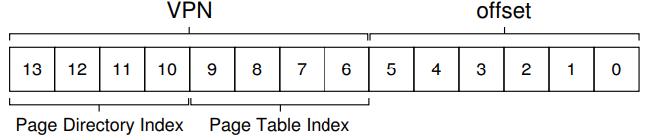

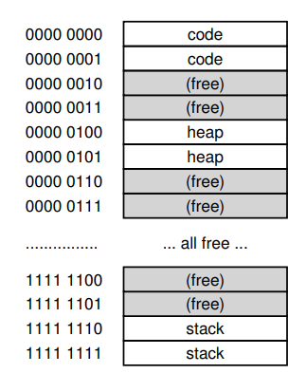
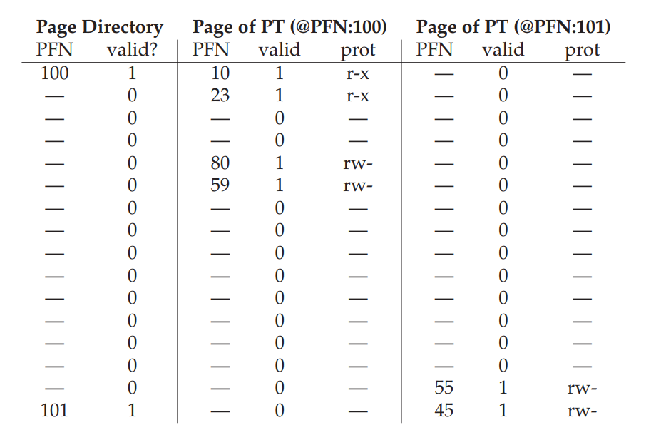
Design 2-Level Page Table (cont.)

Slide 9
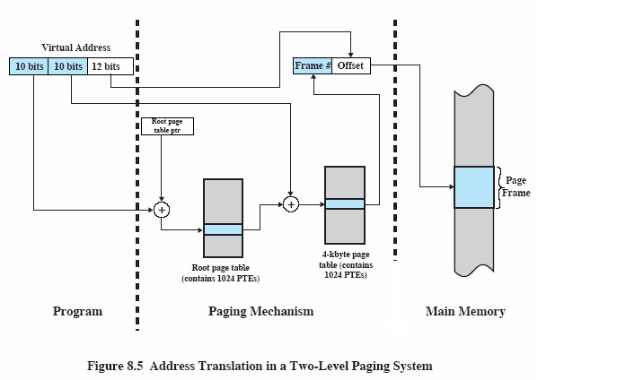
2-level Paging System Summary

Slide 10
Inverted Page Table
Instead of asking each process maintain a page table for itself, OS can have a single table to track the mapping for each frame.
Hence it is of a fixed size.
Each entry in the table stores which page of what process <PID, VPN> the current frame is mapping to.

Slide 11
Inverted Page Table (cont.)
Virtual Address
Physical Address
Page #
Offset
Frame #
Offset
Inverted
Page Table
Page Frame
Frame #
<PID, Page #>
Search
V
M
PID,Page #
matches Page #
and PID
Program
Paging Hardware
Memory

Slide 12
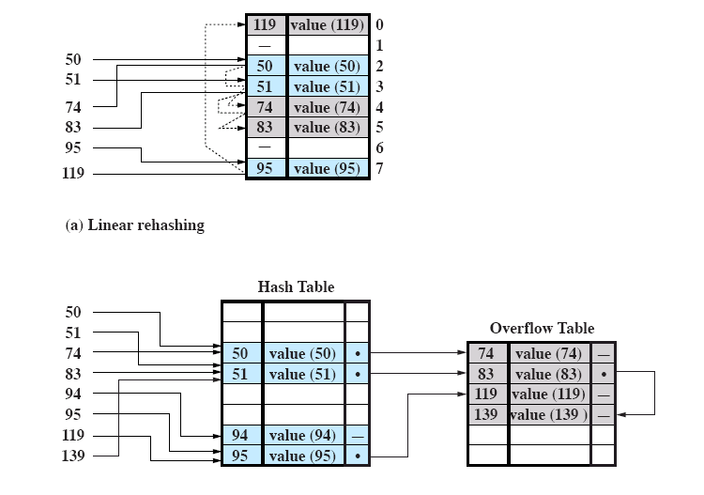
Inverted Page Table (cont.)
BUT searching this gigantic table is slow.
Let’s hash.
Hashing function: X mod 8
(b) Chained rehashing

